Slide 1
Data Structures Summary

Slide 2
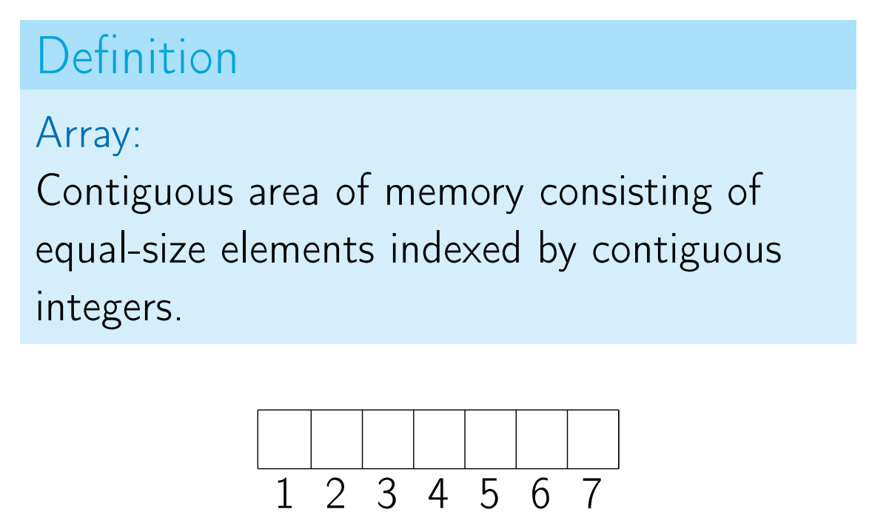
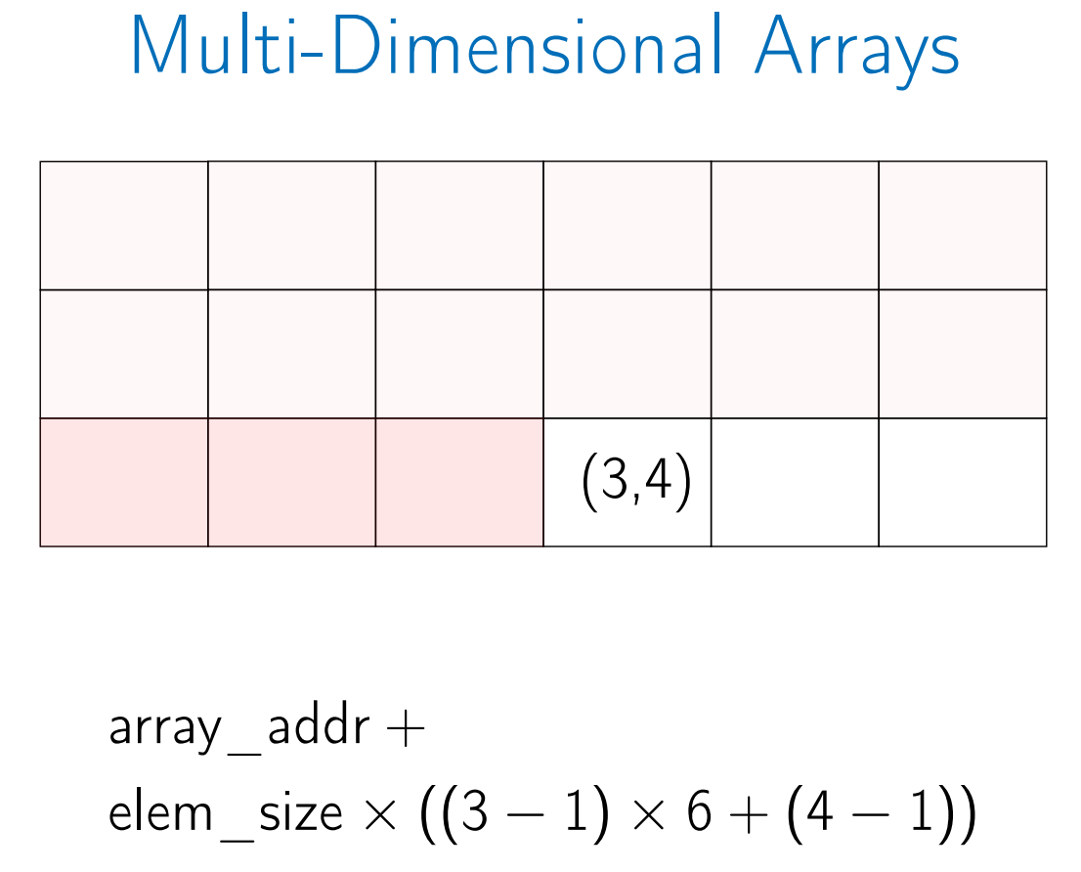
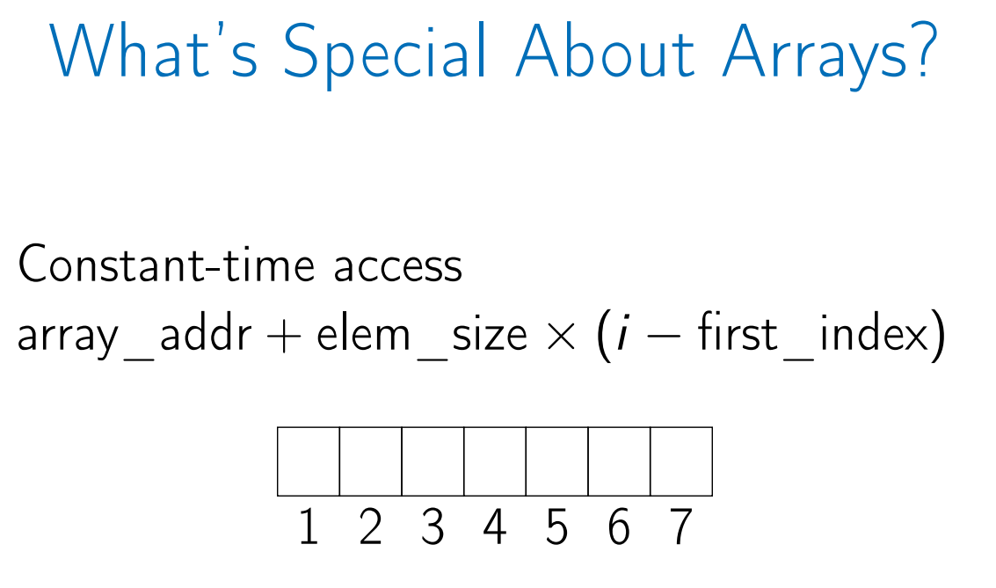
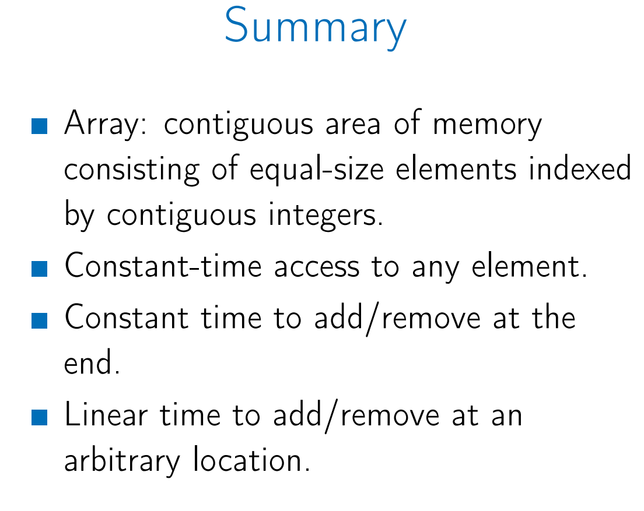
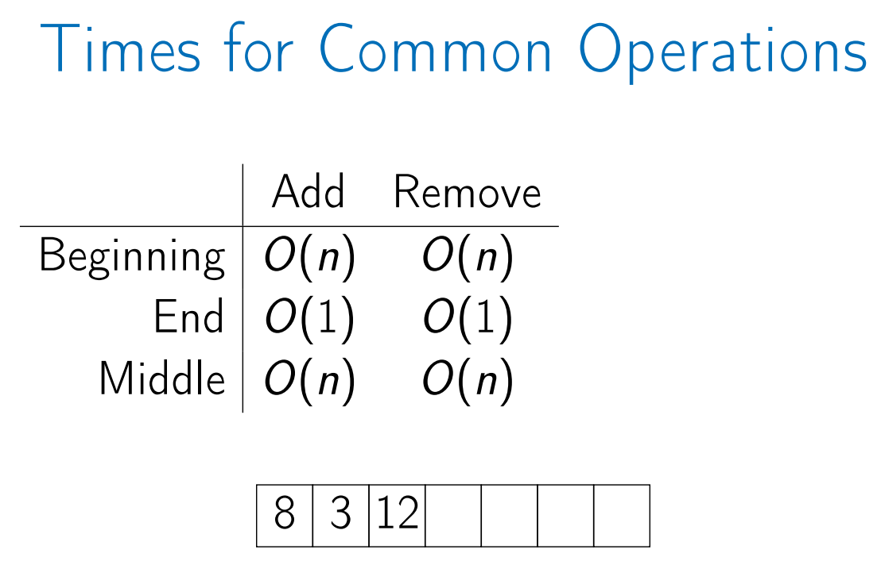
Arrays

Slide 3
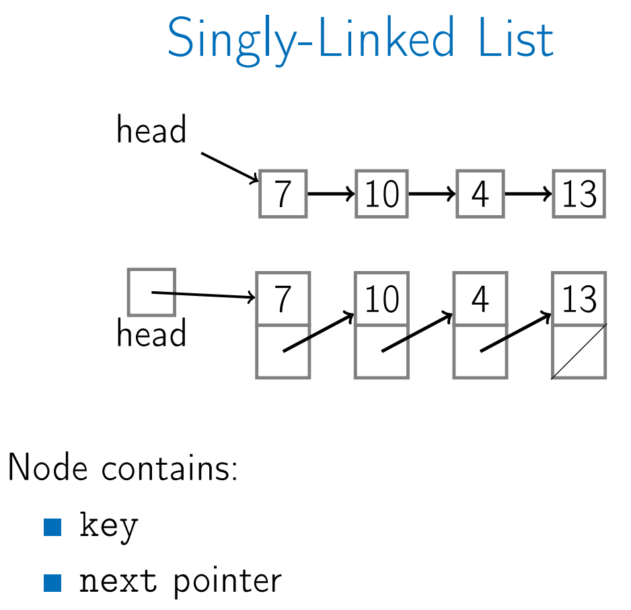
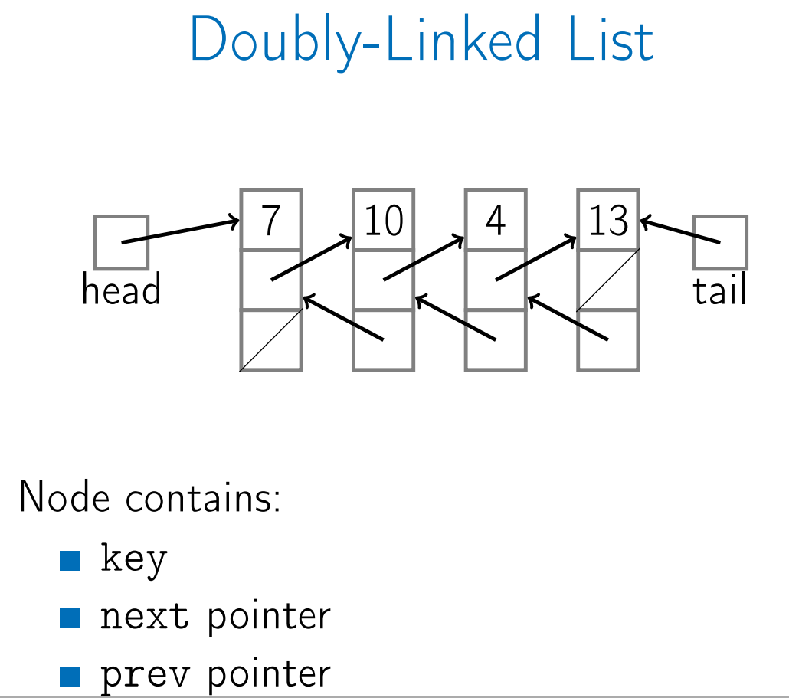
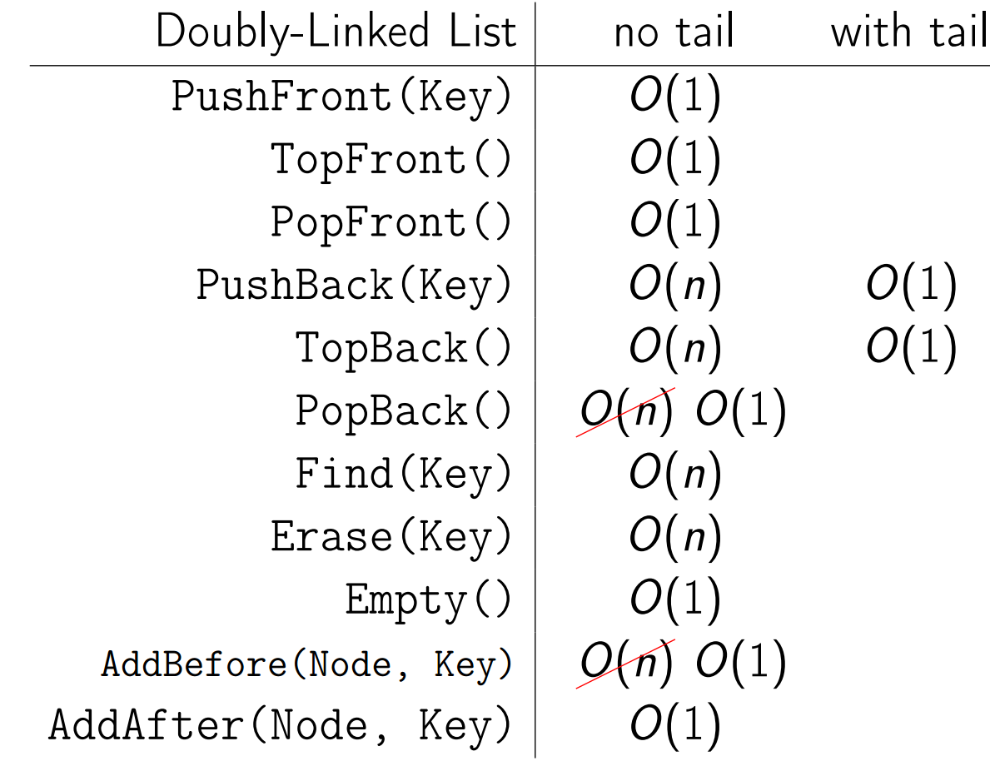
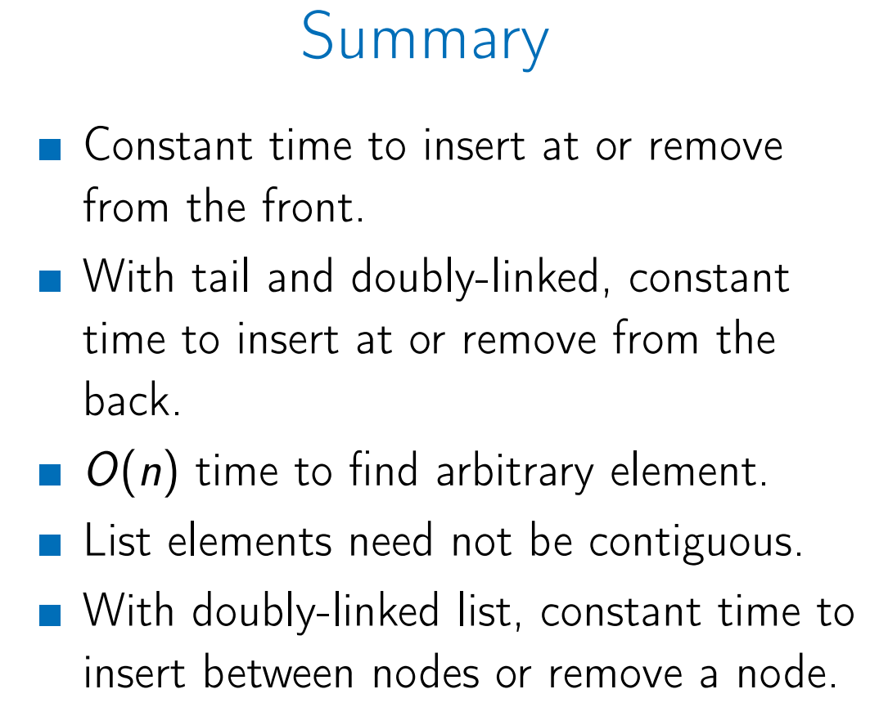
Linked List

Slide 4
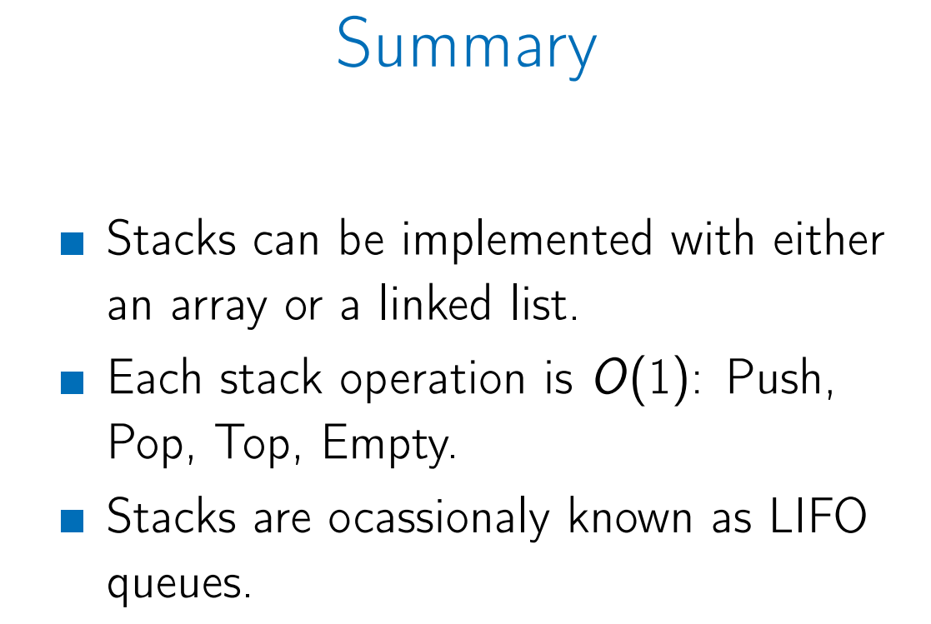
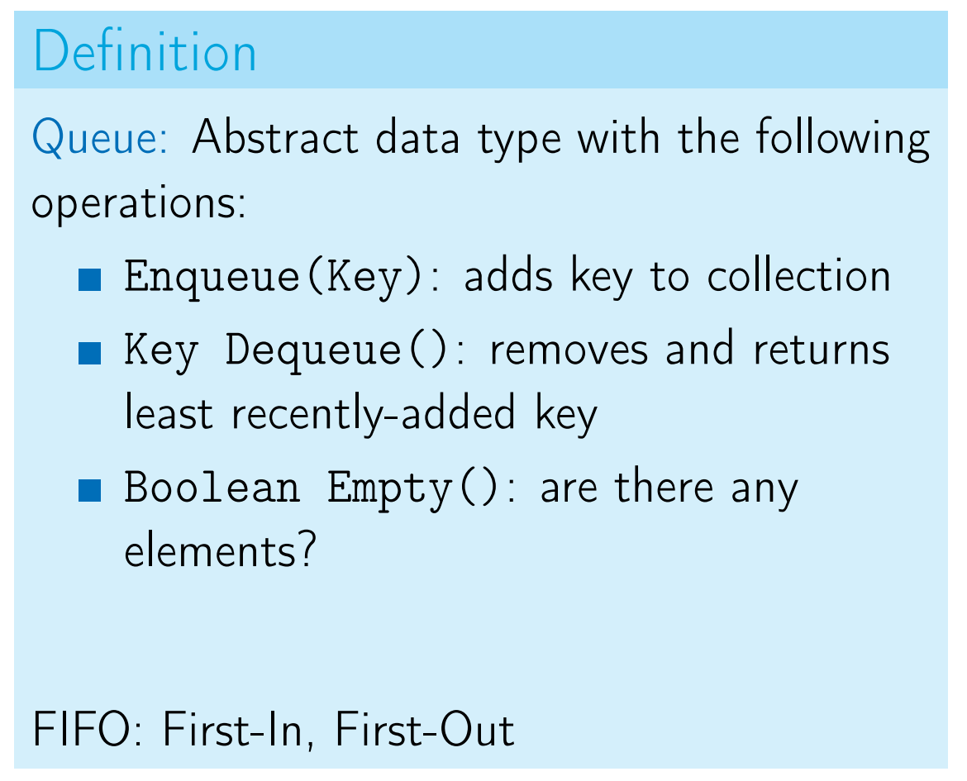

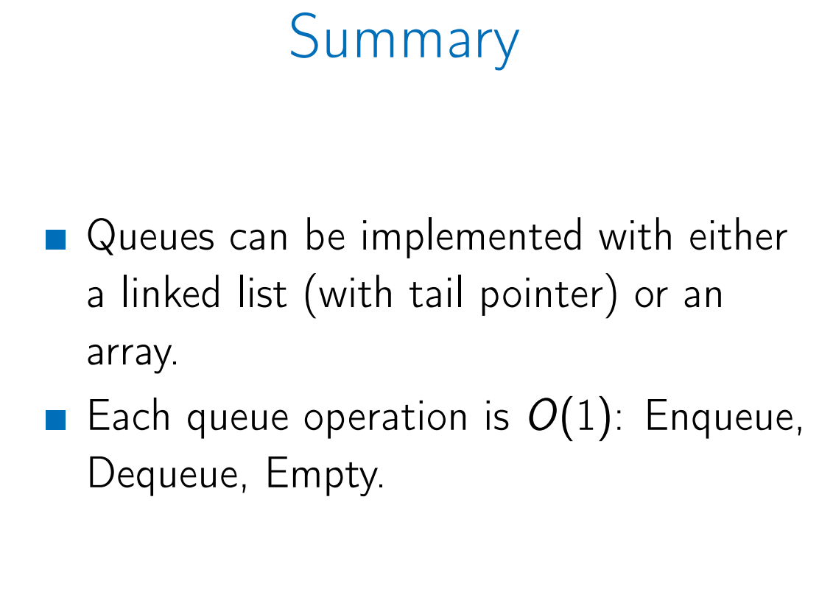
Stacks & Queues

Slide 5
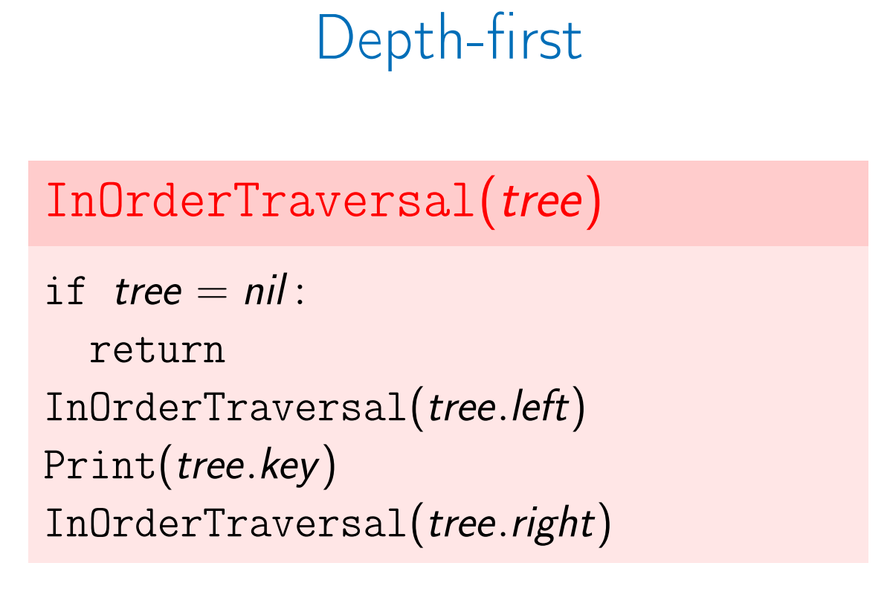
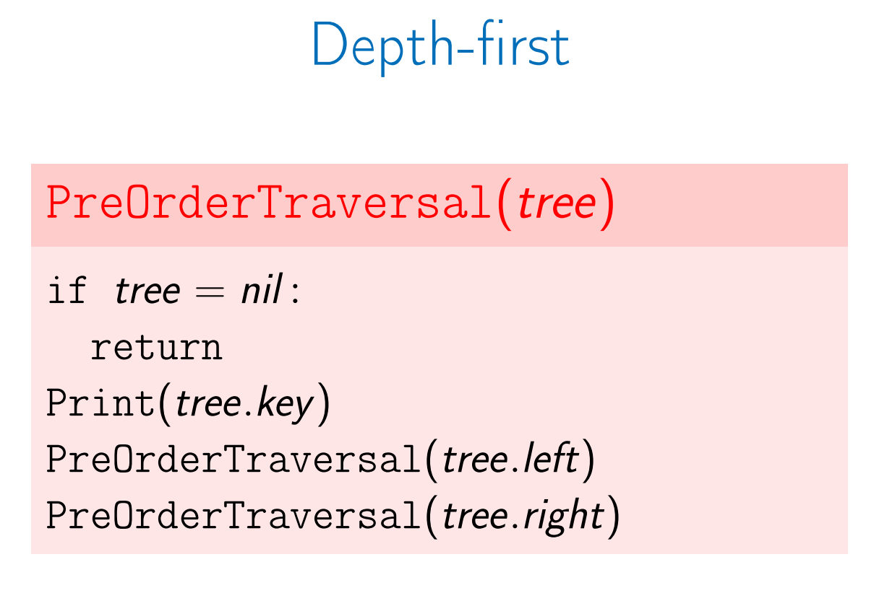
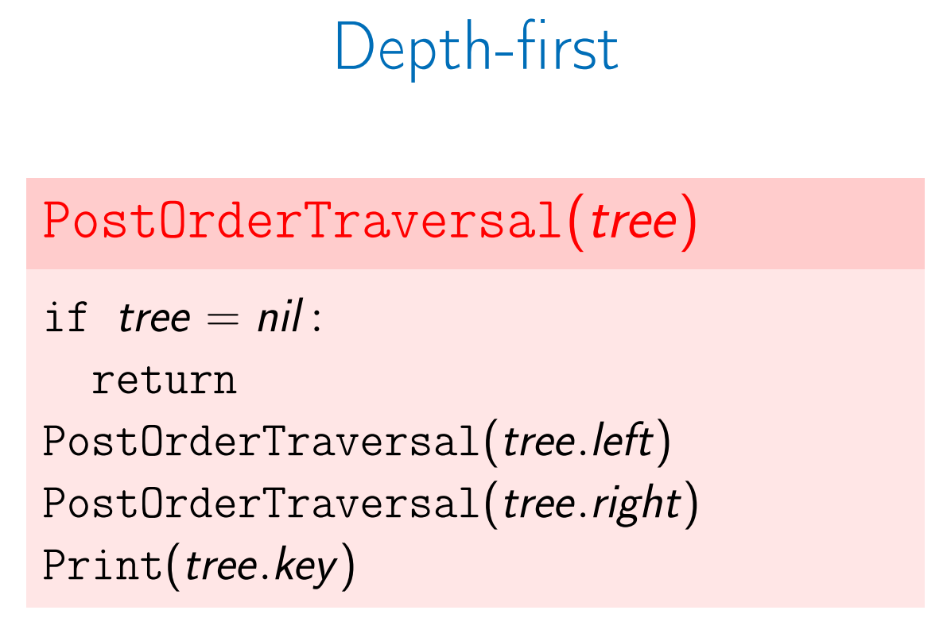
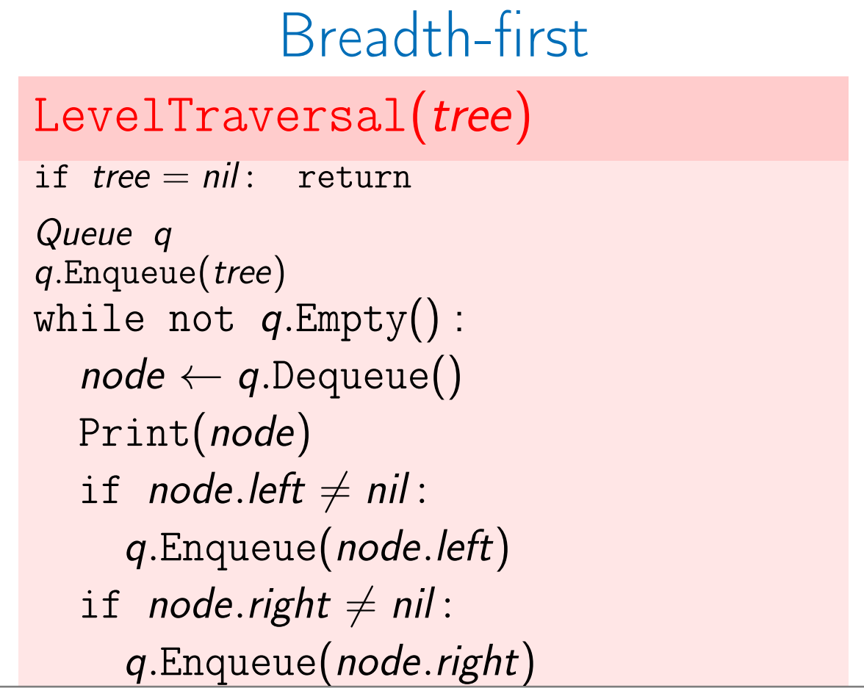
Trees
When working with trees recursive algorithms are common.

Slide 6
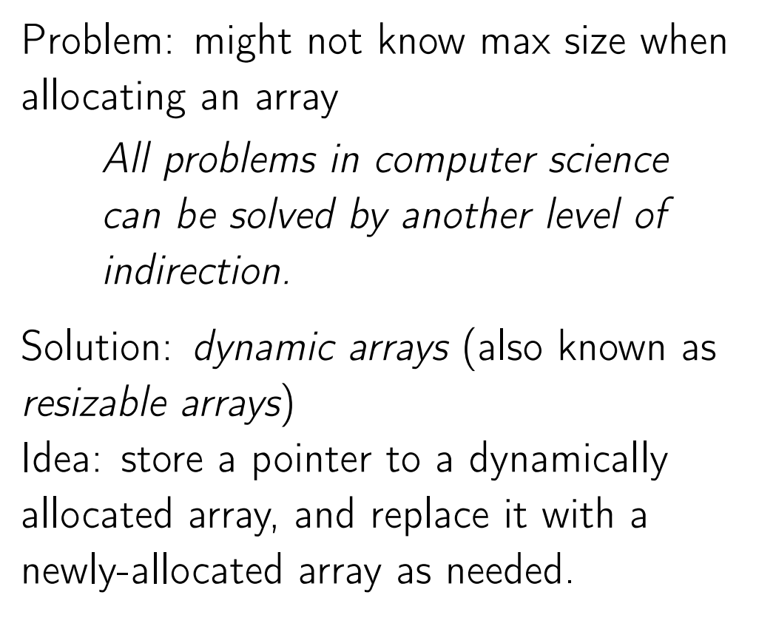
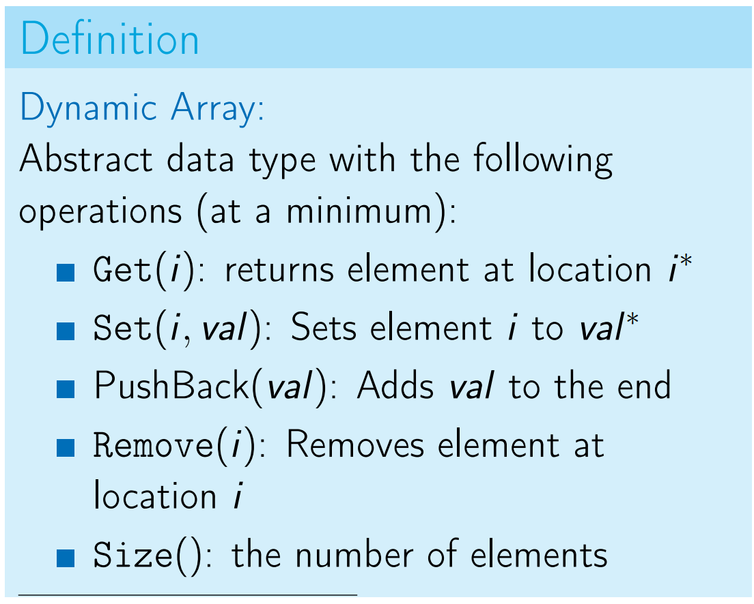
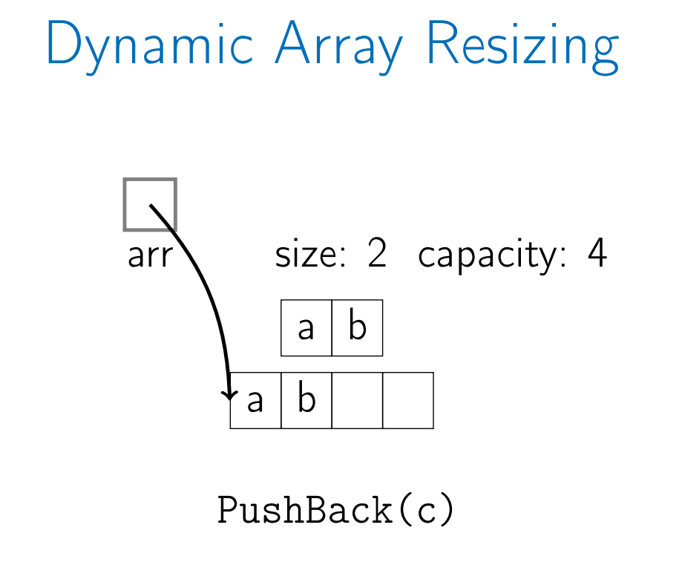
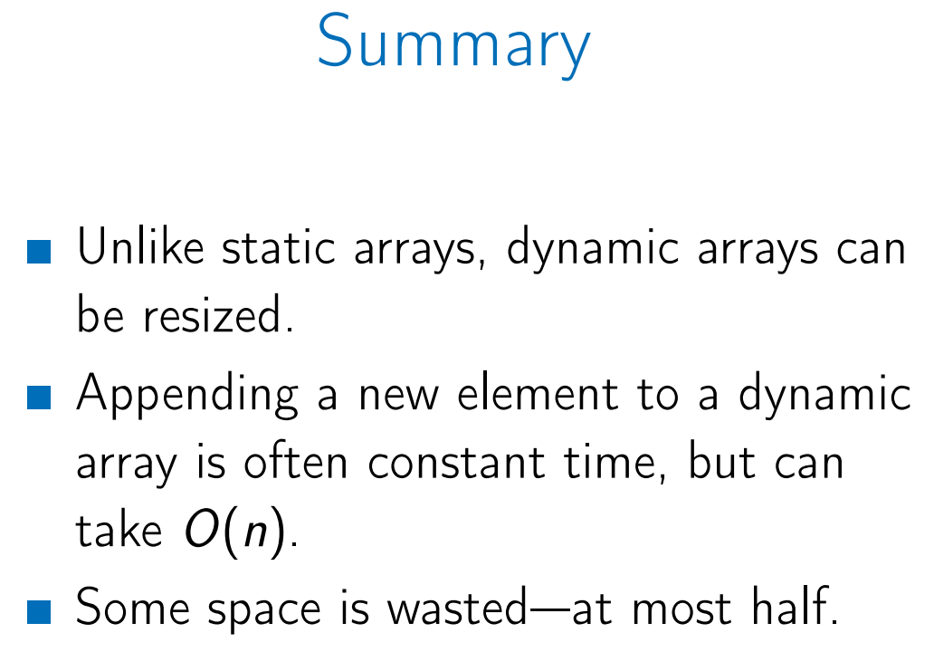
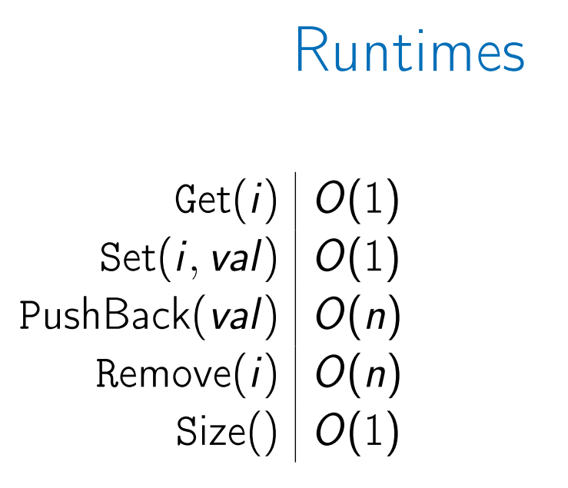
Amortized Arrays (Dynamic Arrays)
Common Implementations:
C++: Vector
Java: ArrayList
Python: List (the only array)

Slide 7
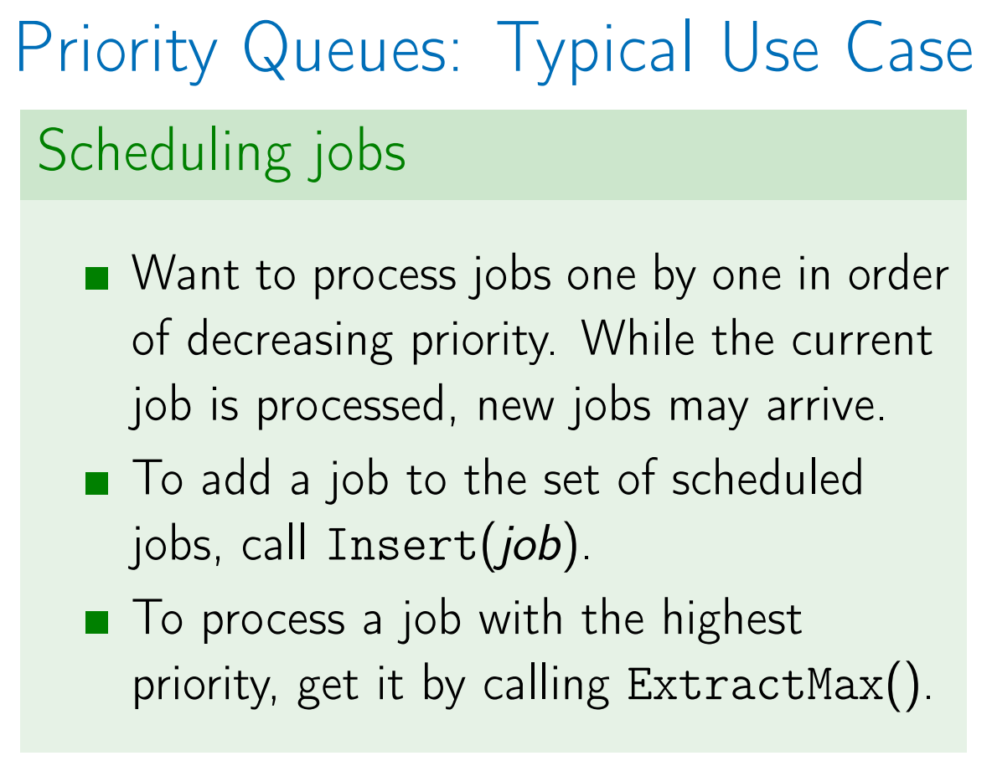
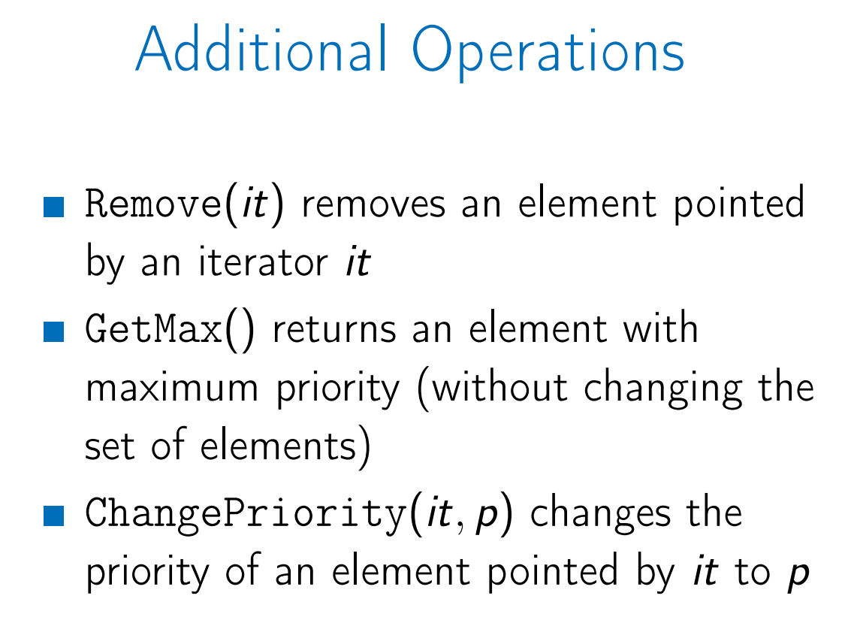
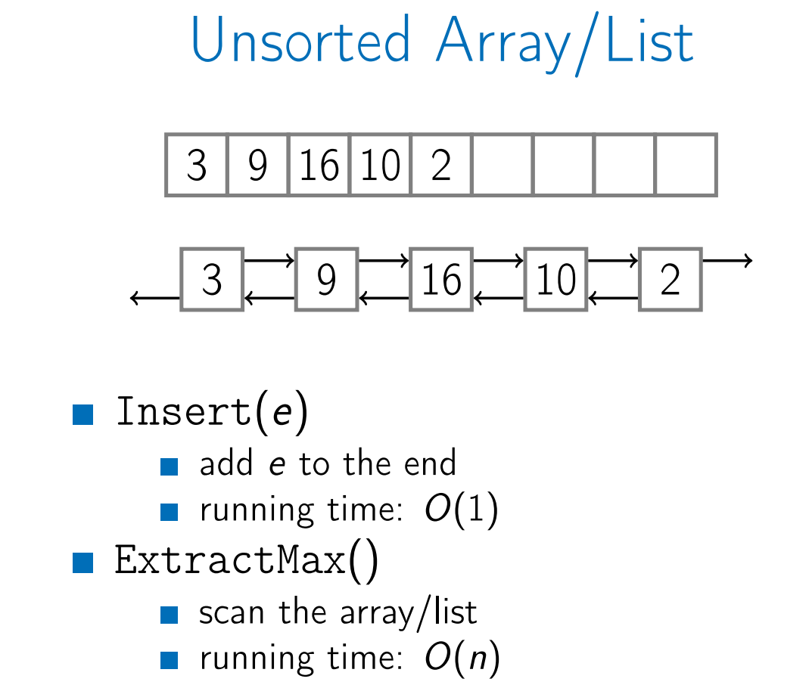
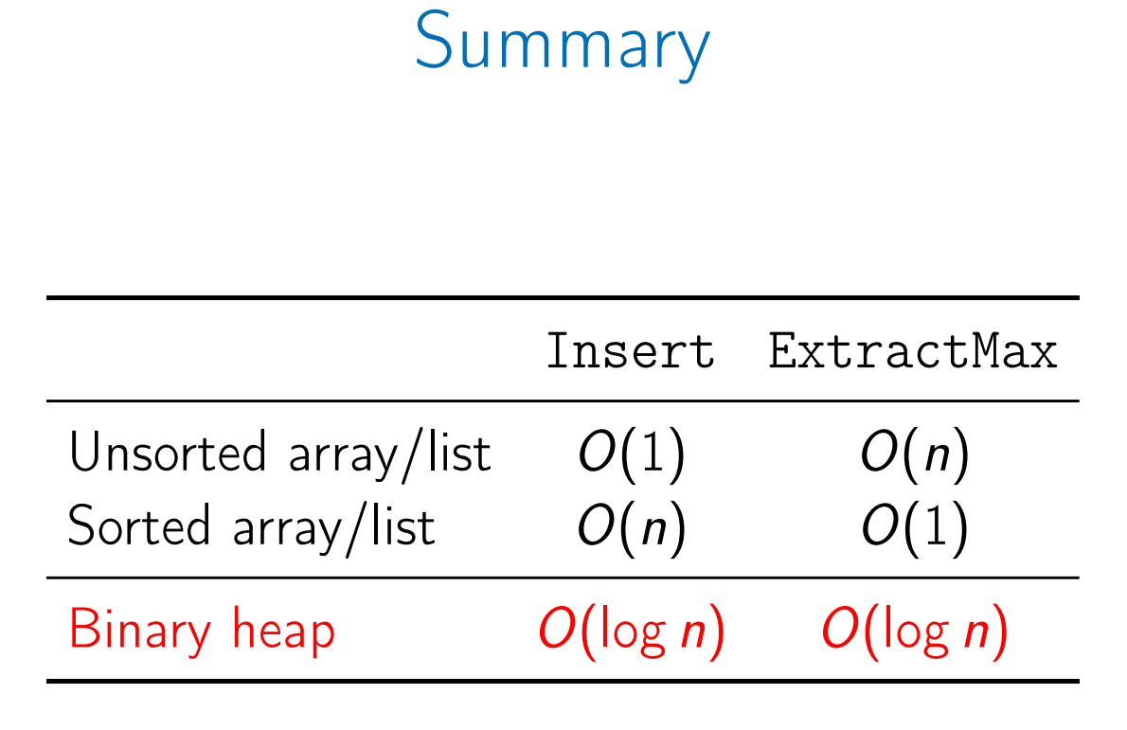
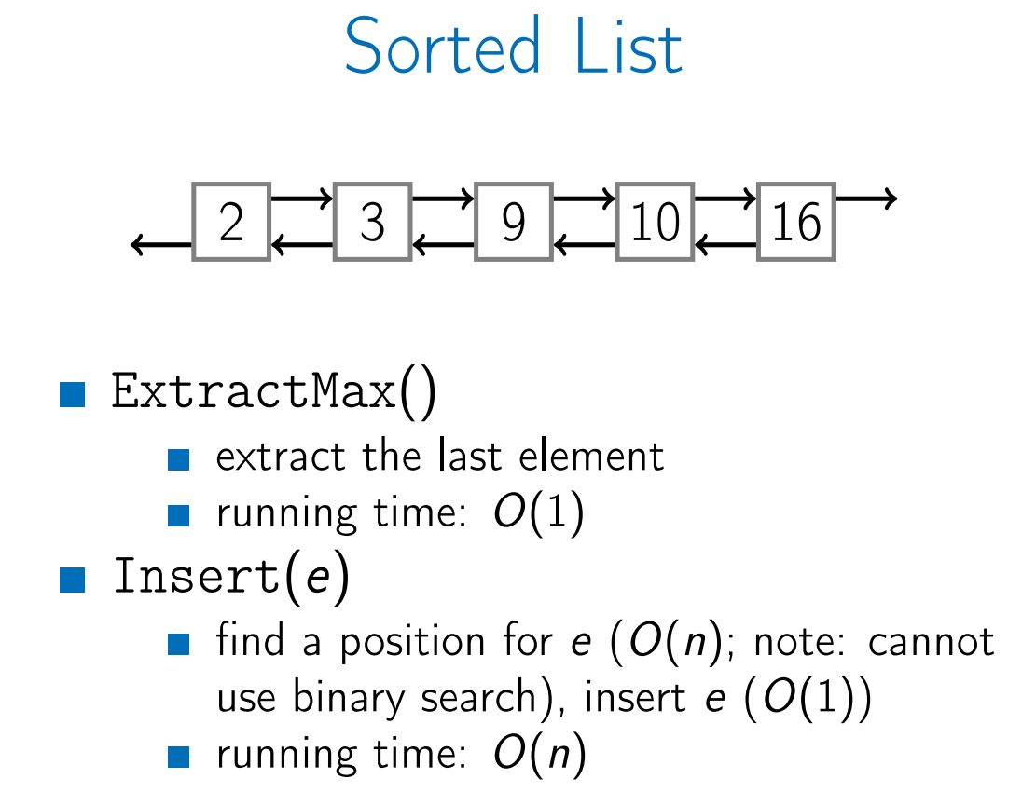
Priority Queues
A priority queue is a generalization of a queue where each element is assigned a priority and elements come out in order by priority.
Common Implementations:
C++: priority_queue
Java: PriorityQueue
Python: heapq
Algorithms that use Priority Queues: Dijsktra’s algo, Prim’s algo, Huffman’s algo, Heap sort

Slide 8
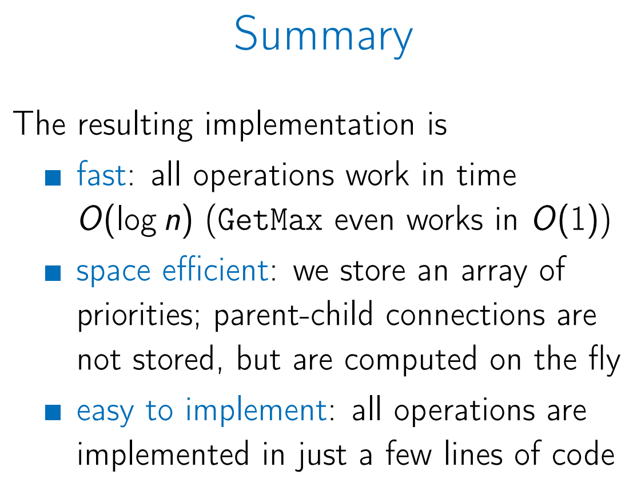
Priority Queues - Binary Heaps
Advantages of Complete binary tree :
Low Height O(log n)
Store as Array (parent(i) = floor(i/2), leftchild(i) = 2i, rightchild = 2i+1) (1-based Array)
Which binary heap operations modify the shape of the tree?
Only Insert and ExtractMax (Remove changes the shape by calling ExtractMax).
To insert an element, insert it as a leaf in the leftmost vacant position in the last level and let it sift up.
To extract the maximum value, replace the root by the last leaf and let it sift down.
GetMax works in time O(1), all other operations (GetMax, ExtractMax, Insert, Remove, SiftUp, SiftDown, ChangePriority) work in time O(tree height)
We definitely want a tree to be shallow.
How to keep a tree shallow ?. A binary tree is complete if all its levels are filled except possibly the last one which is filled from left to right.
A complete binary tree with n nodes has height at most O (log n).
Binary max-heap is a binary tree (each node has zero, one, or two children) where the value of each node is at least the values of its children.
All operations work in time O (log n)

Slide 9
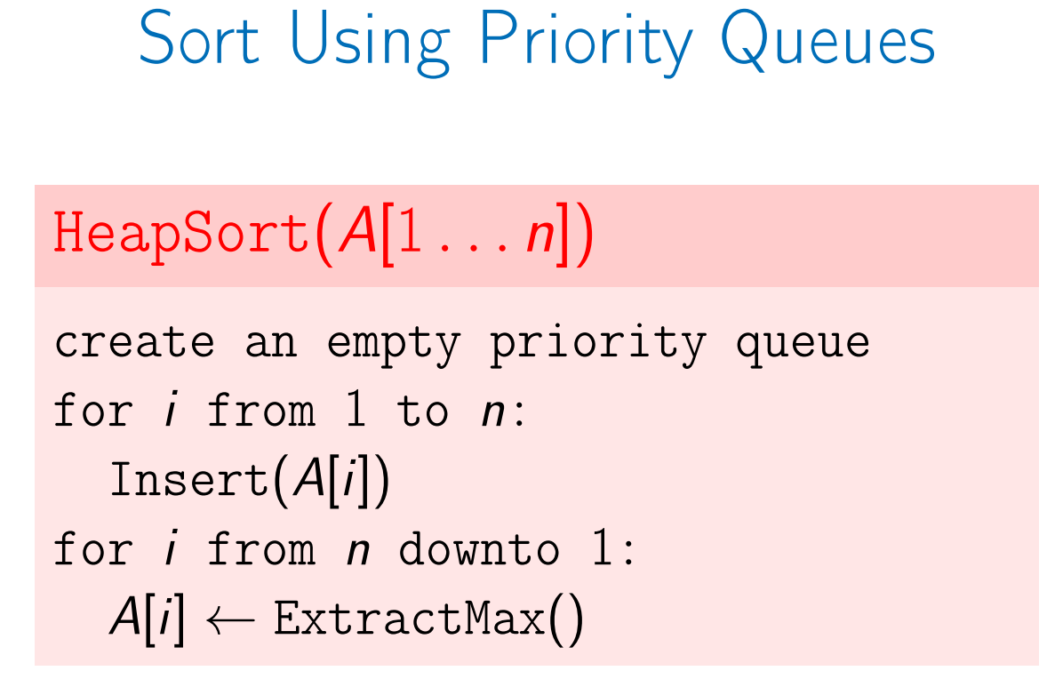
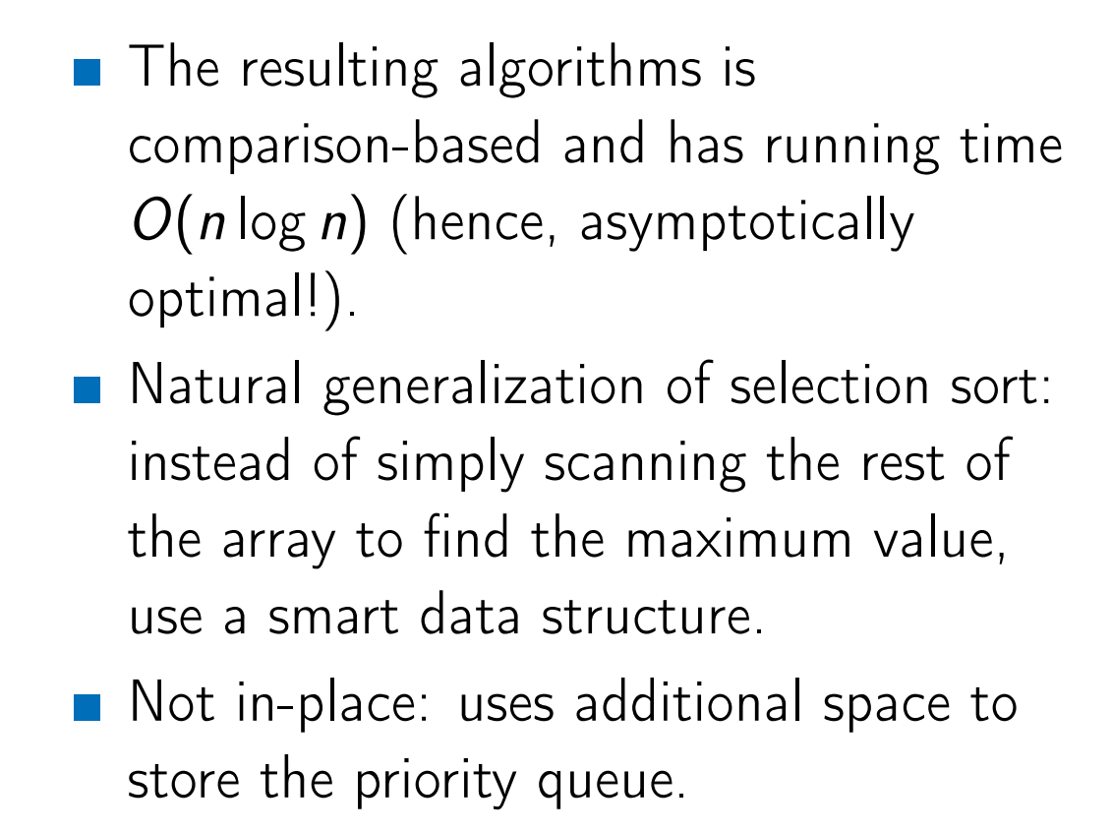
Heap Sort
Not In-Places

Slide 10
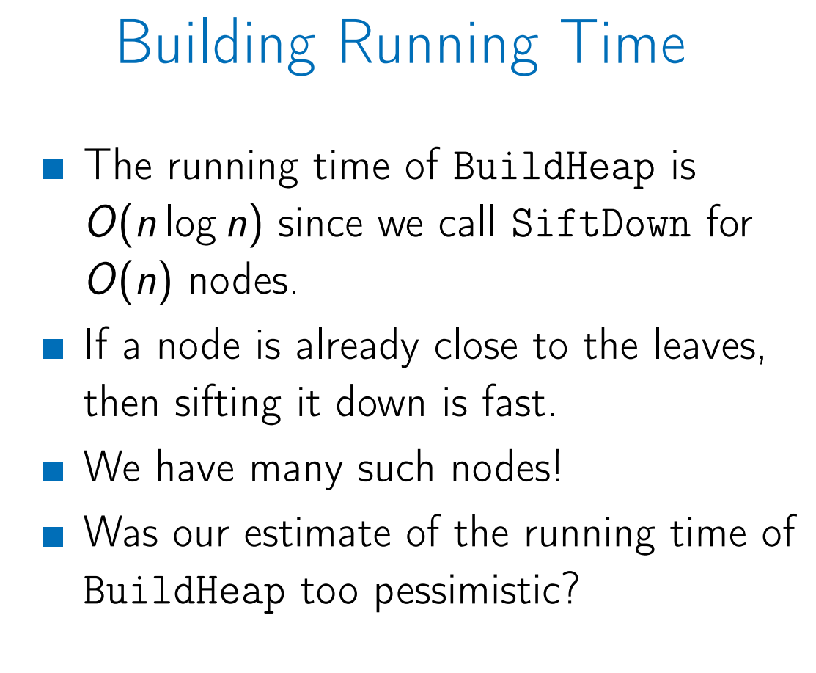
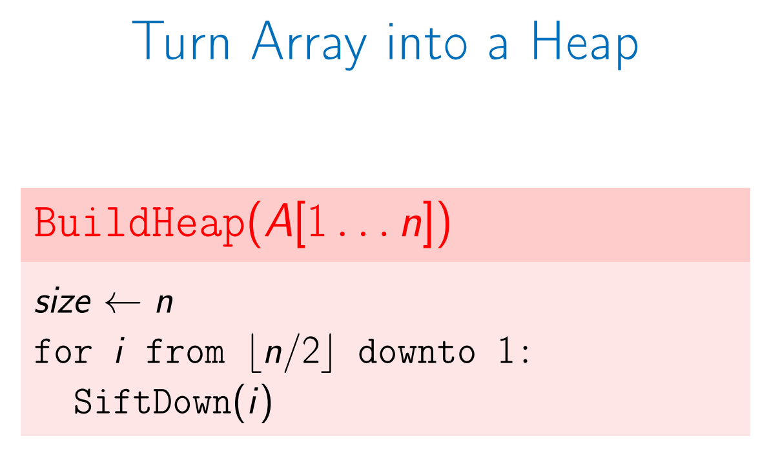
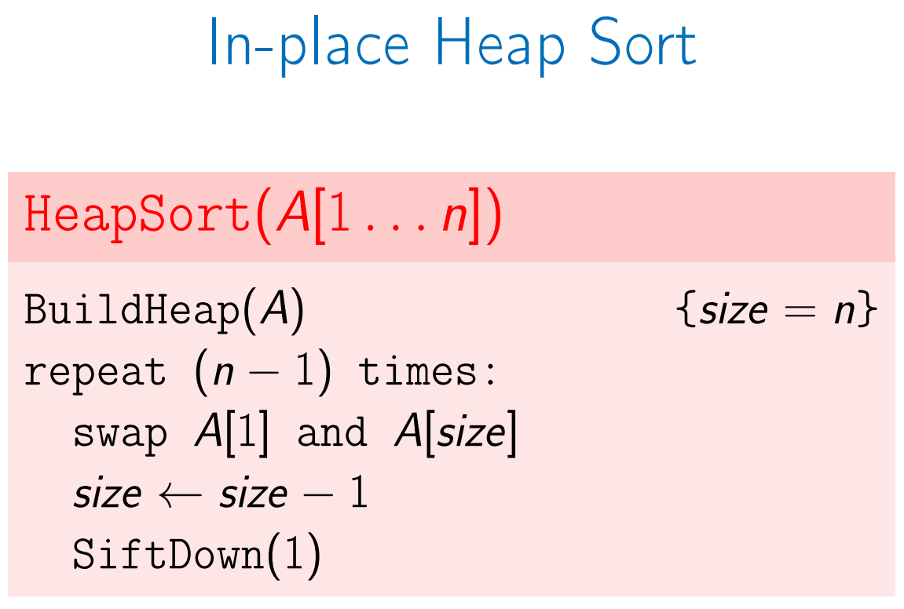
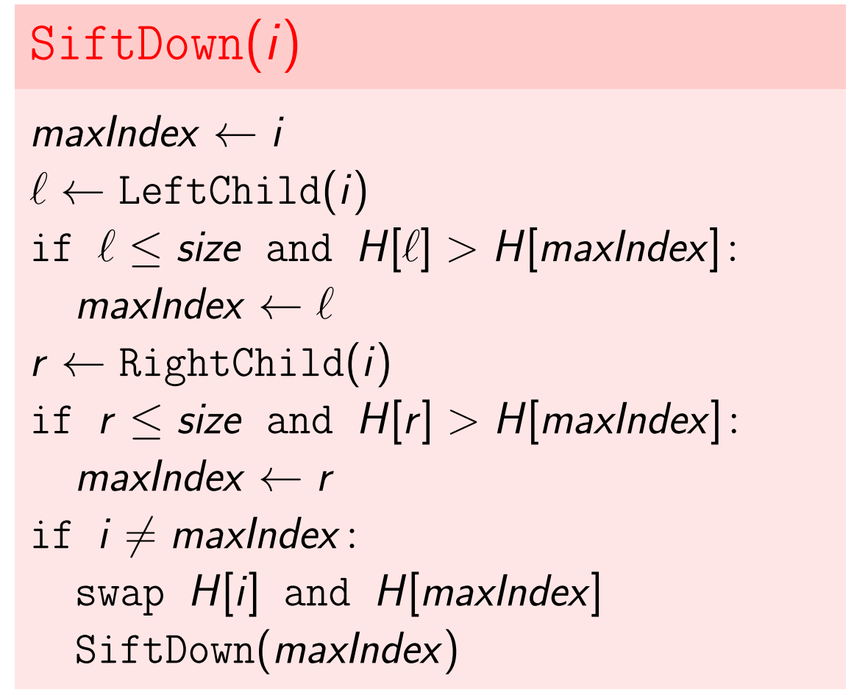
In-place Heap Sort
GetMax works in time O(1), all other operations (GetMax, ExtractMax, Insert, Remove, SiftUp, SiftDown, ChangePriority) work in time O(tree height)
We definitely want a tree to be shallow.
How to keep a tree shallow ?. A binary tree is complete if all its levels are filled except possibly the last one which is filled from left to right.
A complete binary tree with n nodes has height at most O (log n).
Running time: O (n log n)
Heap sort is a time and space efficient comparison-based algorithm: has running time O (n log n), uses no additional space.

Slide 11
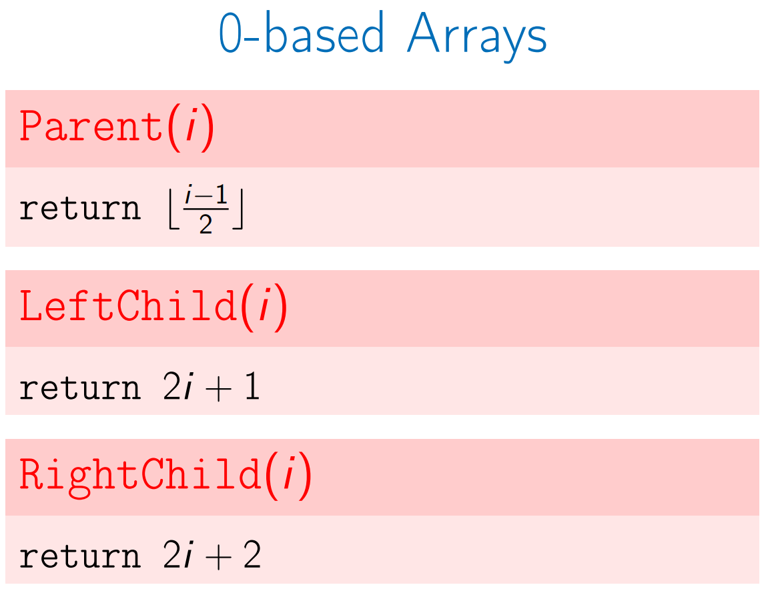
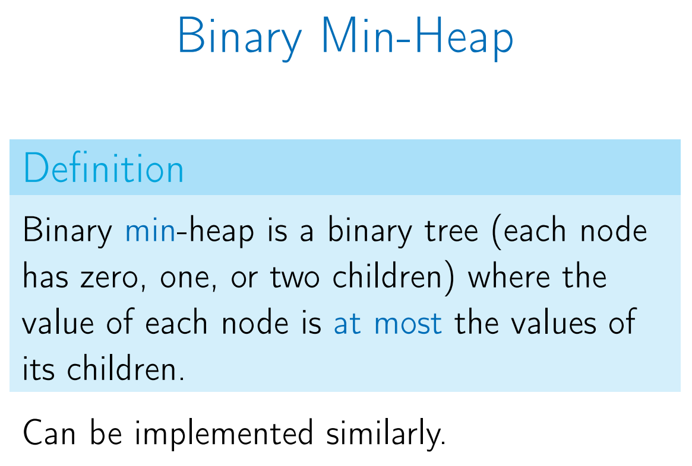
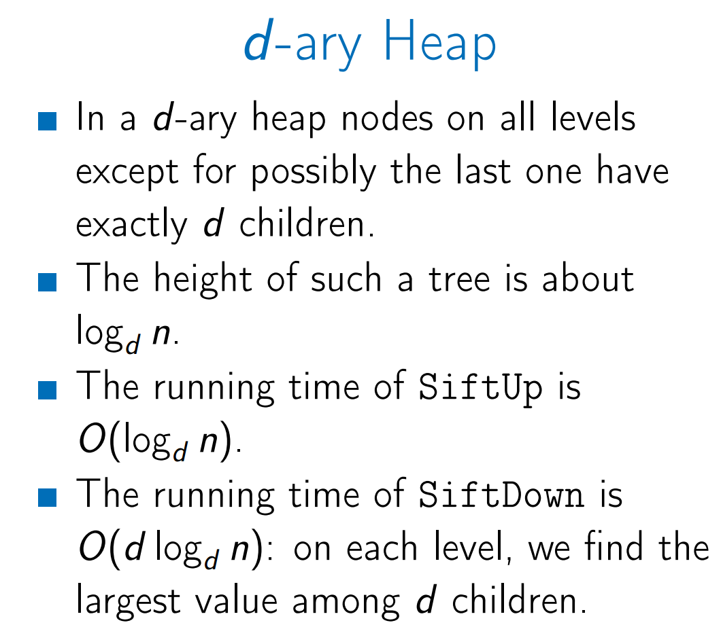
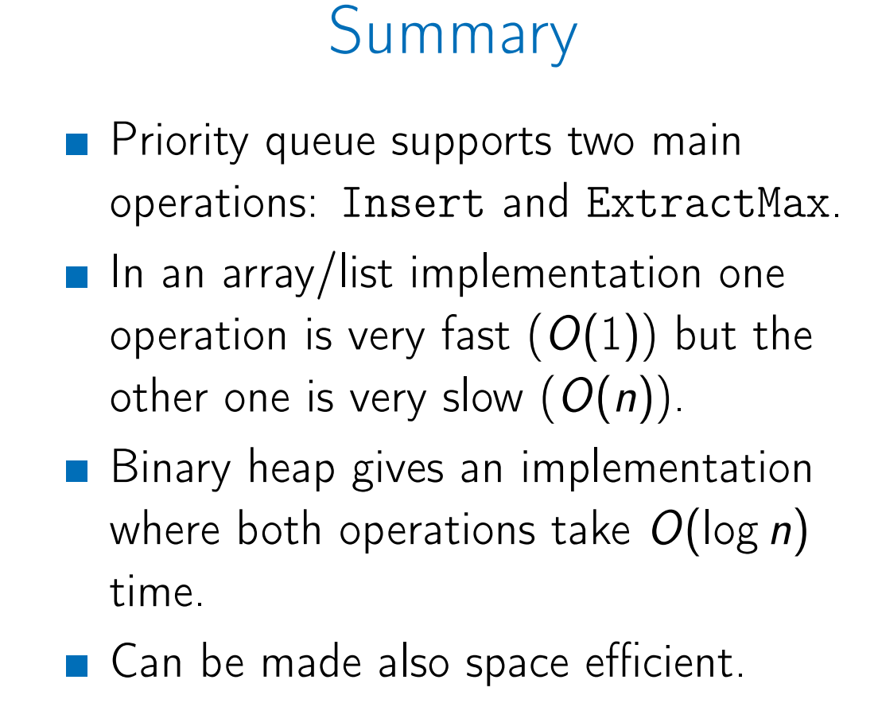
Priority Queue – Final Remarks

Slide 12
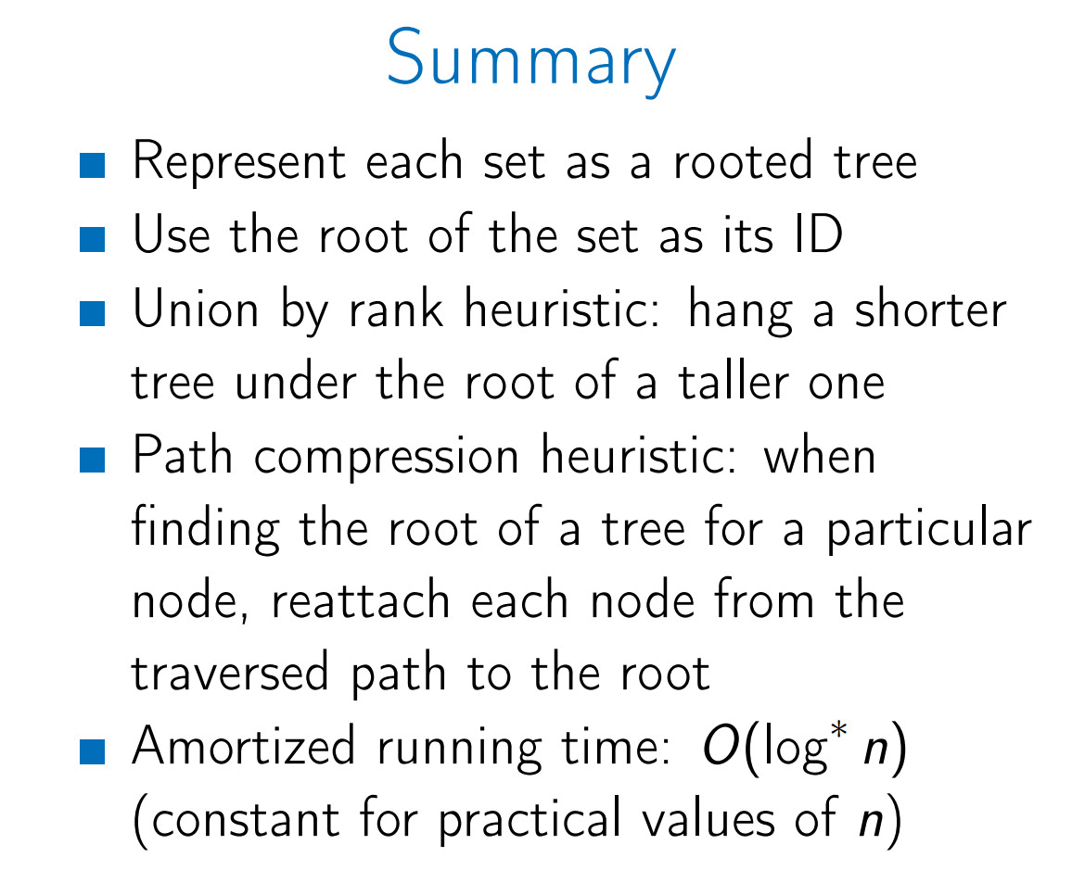
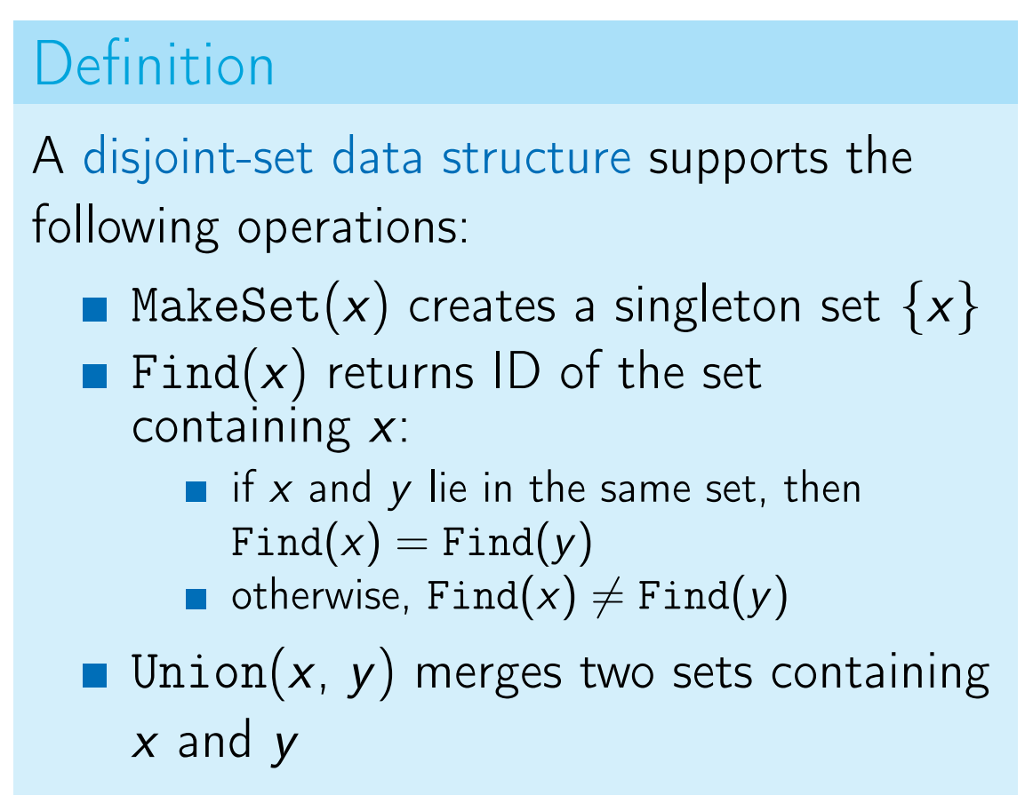
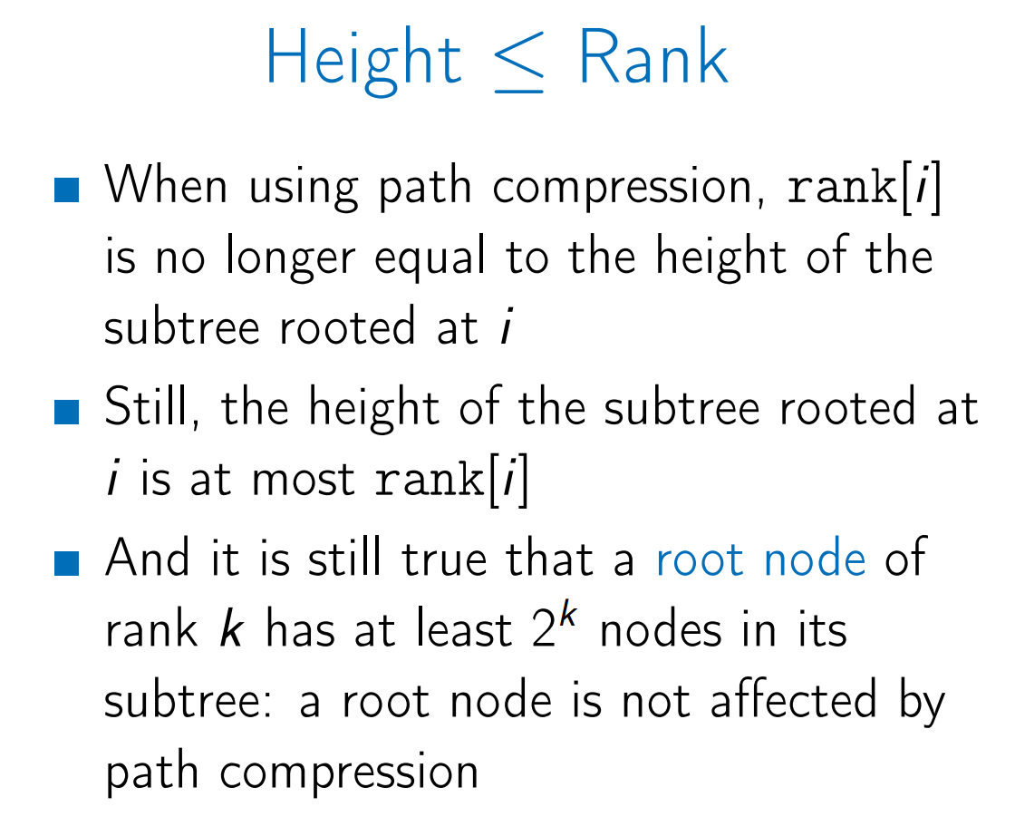
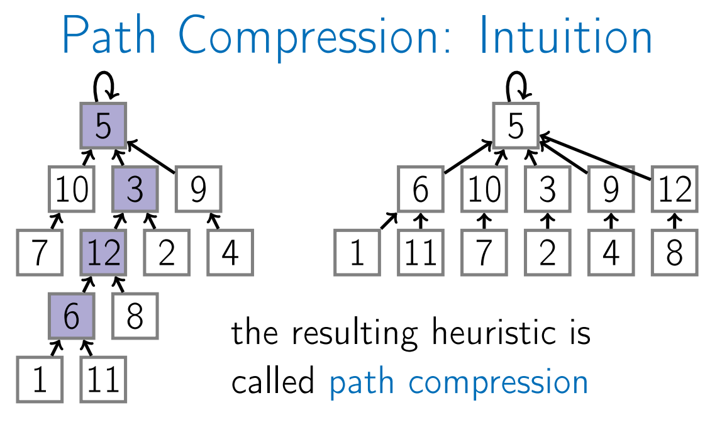
Disjoint Sets
Union by Rank
When merging two trees we hang a shorter one under the root of a taller one
Hanging a shorter tree under a taller one is called a union by rank heuristic.
Lemma: The height of any tree in the forest is at-most log2n.
Lemma: Any tree of height k in the forest has at-least 2^k nodes.
The union by rank heuristic guarantees that Union and Find work in time O (log n).
Path Compression
When using Find(x), the algo traverses from all the nodes in the path from node x to root.
In Path compression heuristics, we make the parent of all the nodes on this path the root node.
The amortized running time of a single operation is O(log*n). For practical values of n, log*n <= 5

Slide 13
Hash Tables
Methods to Implement Hashing
Direct Addressing:
Integer Array of size n.
Access time and update time is O(1)
Biggest disadvantage is that the memory consumption is O(N).
List based Mapping:
Store only active data in the list (linkedList).
Memory usage is θ(n)
Append, Access, Top and Pop are θ(1)
Disadvantage is that now Find and Erase are θ(n)
Hash Function
For any set of objects S and any integer m > 0, a function h: S → {0, 1, .., m-1} is called a hash function. m is called the cardinality of hash function h.
When h(o1) = h(o2) & o1 != o2 then, it is collision.
Chaining Approach
In the chaining approach, the hash table is an array of linked lists i.e., each index has its own linked list.
All key-value pairs mapping to the same index will be stored in the linked list of that index.
Let c be the length of the longest chain in A. Then the running time of HasKey, Get and Set is θ(c+1).
Let n be the number of different keys O currently in the map and m be the cardinality of the hash function. Then the memory consumption for chaining is θ(n+m).
α = n/m is called load factor
Both small m and c is required.
Implementation of set and map using chaining is called a hash table.
Set is set() and Map is dict() in Python
Universal Family – Let U be the universe – the set of all possible keys. A set of hash function is called universal family if for any two keys x, y Є U, x != y the probability of collision is <= 1/m.
If h is chosen randomly from a universal family, the average length of the longest chain c is O(1 + α)
If h is from universal family, operations with hash table run on average in time O(1 + α).
Ideally load factor 0.5 < α < 1.
Use O(m) = O(n/α) = o(n) memory to store n keys.
Use dynamic has tables, rehash when load factor > 0.9. Single rehashing takes O(n) time, but amortized running time of each operation with hash table is still O(1) on average.
Hashing Integers
Hashing Strings

Slide 14
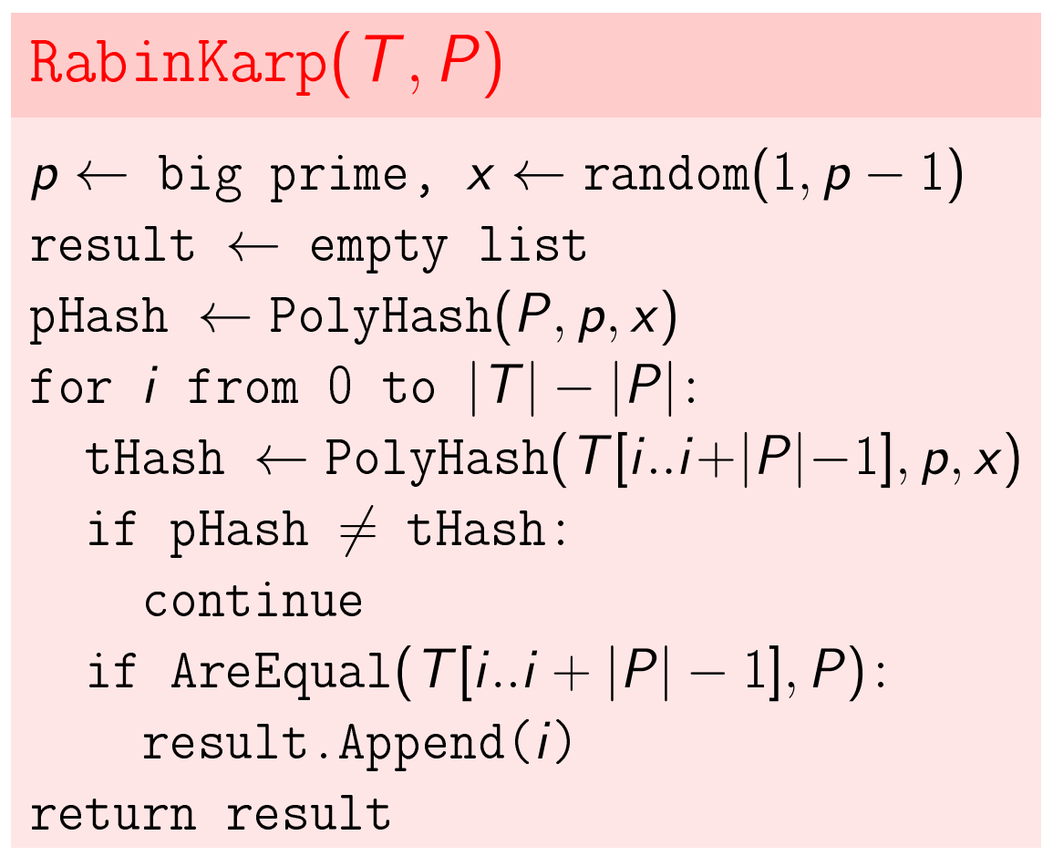
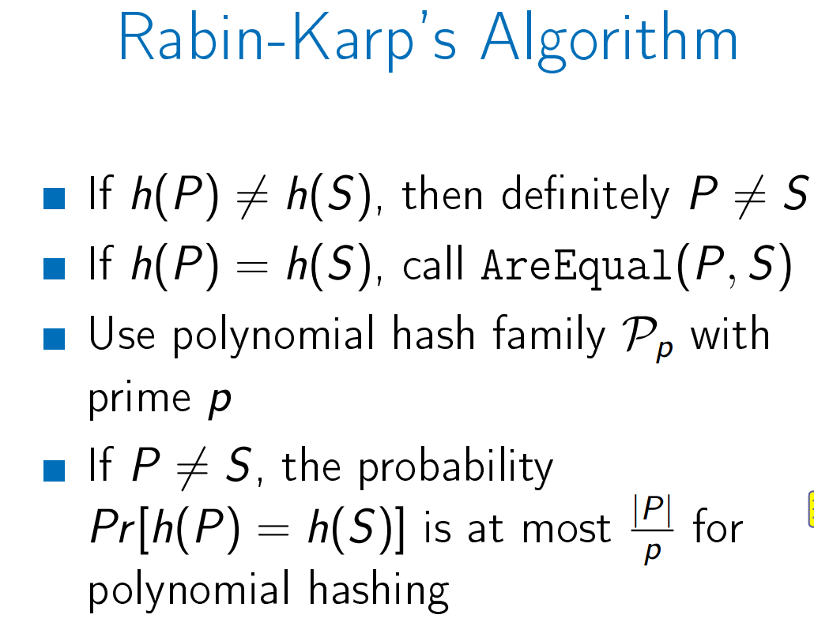
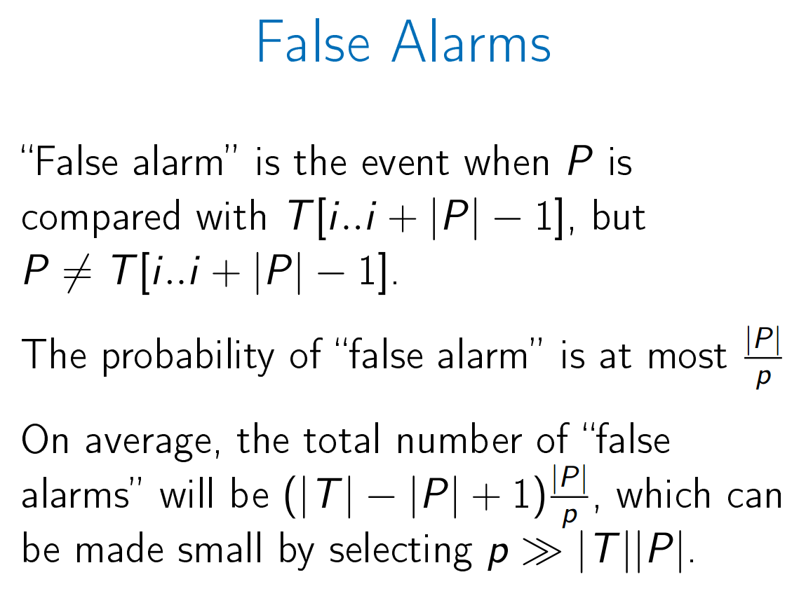
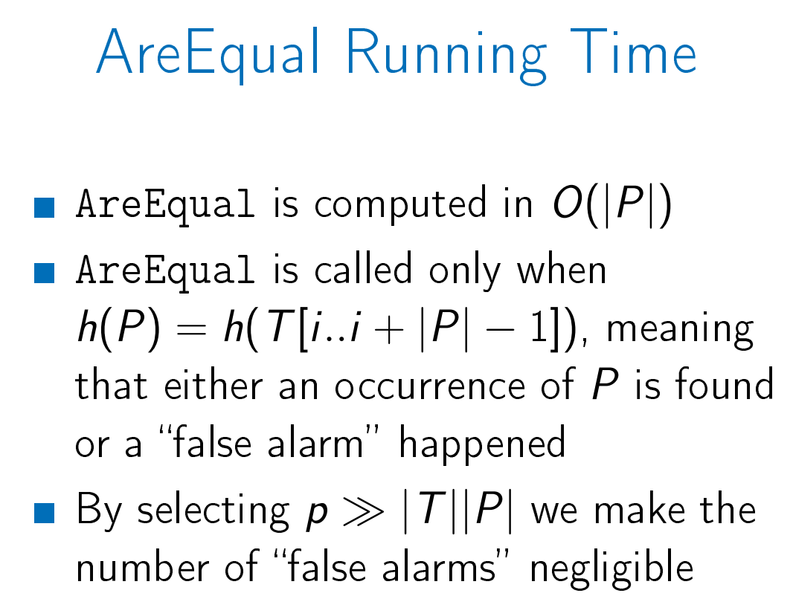
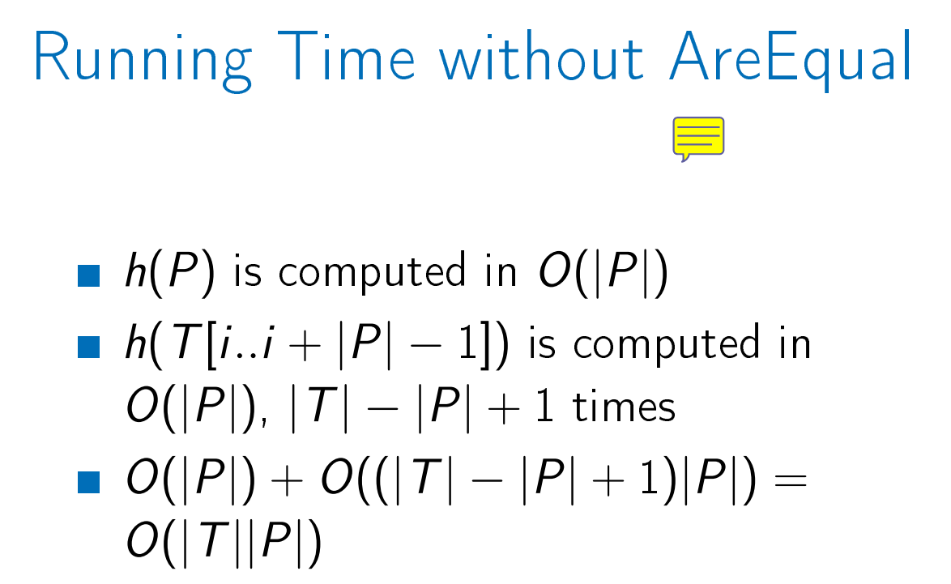
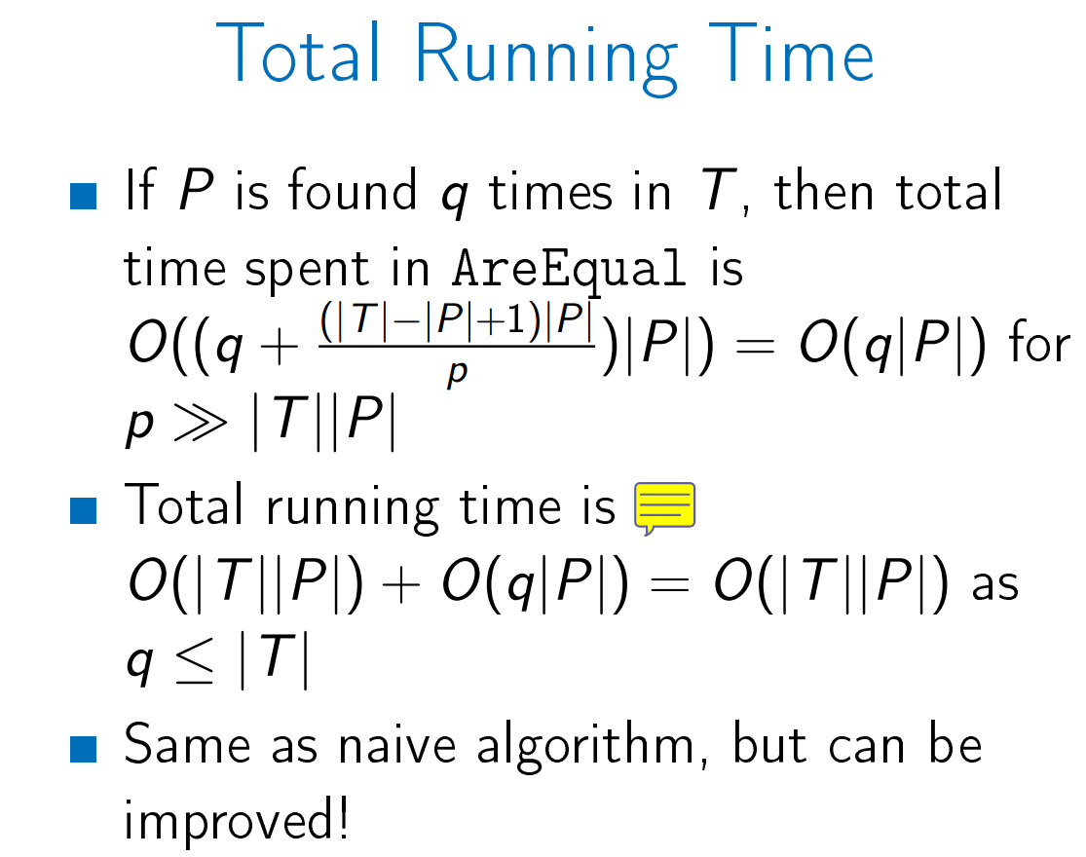
Rabin’s Karp Algo
Total running time of AreEqual is q|P| considering that we reduced the “False Alarms” by minimizing (|T|-|P|+1)/p by making p>>|T||P|
The time spent in computing the hashes is O|T||P|.
The main idea behind RabinKarp algo is to reduce compute hashing time by pre-computing hashes beforehand in time.
Main Idea behind pre-computing hashes is polynomial hashes of two consecutive substrings of T are very similar.
This way computing hashes time is reduced to O(|T| + |P|) instead of O(|T||P|).
Search Pattern in Text
Search a pattern P in text T.
Naïve Algo takes time O(|T||P|)
RabinKarp Algorithm
In RabinKarp Algo instead of comparing each substring, the idea is to compare the hash value of the substring and the pattern first and if they match then compare substrings.

Slide 15
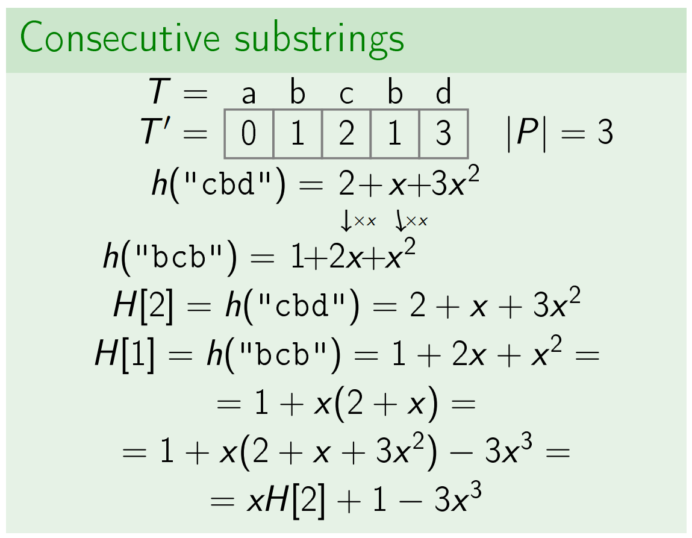
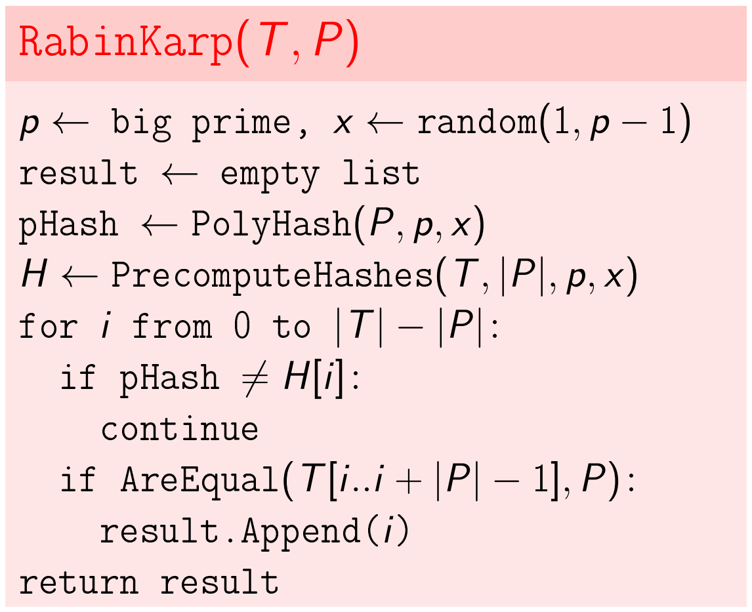
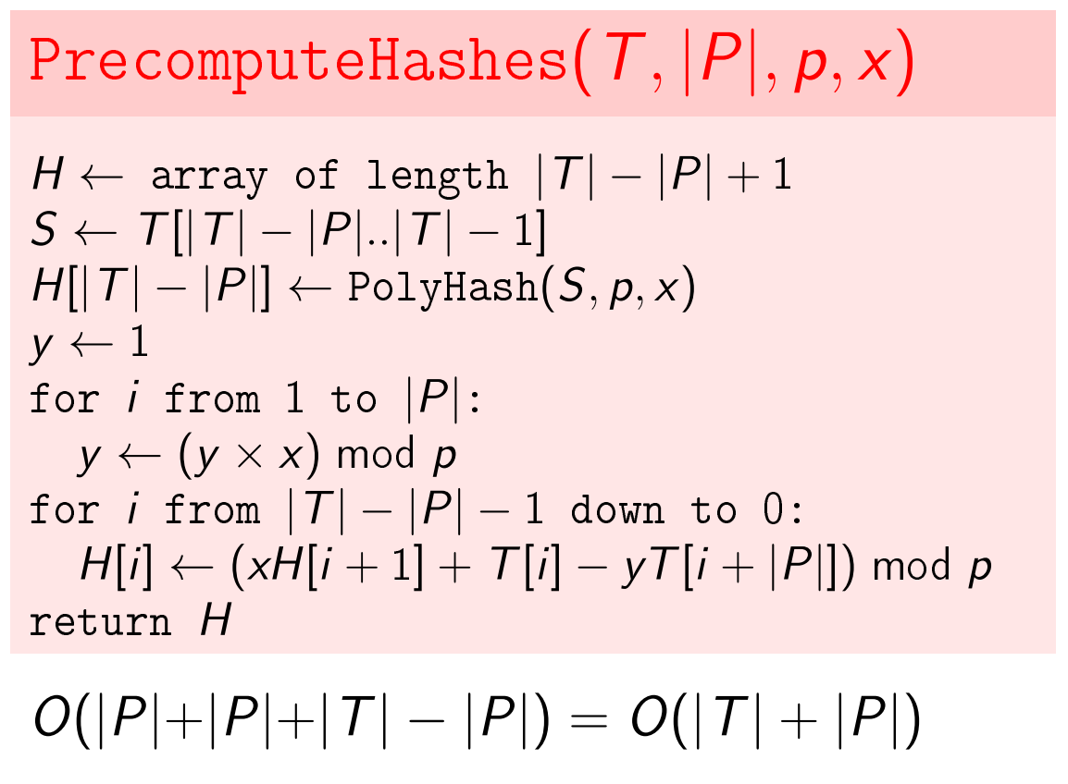

Rabin’s Karp Algo
The average and best-case running time of the Rabin-Karp algorithm is O(|T|+|P|+q|P|), but its worst-case time is O(|T||P|). Worst case of Rabin-Karp algorithm occurs when all characters of pattern and text are same as the hash values of all the substrings of txt[] match with hash value of pat[]. For example, pat[] = “AAA” and txt[] = “AAAAAAA”.

Slide 16












Binary Search Trees
Delete (N)
Purpose of Trees DS :
The main purpose of this DS is to get the best running time for these 4 operations:
RangeSearch(x,y), NearestNeighbors(x), Insert(x), Delete(x)
Search Tree Property:
X’s key is larger than the key of any descendant of its left child.
And smaller than the key of any descendant of its right child.
Find (k, R)
If key is not present at least you’ll find where the key should be inserted.
Insert (k, R)
Next(N)
RangeSearch(x,y,R)

Slide 17









Binary Search Tree Applications
Order Statistics
Given the root of a Tree and a number, k returns the kth smallest element in T.
N.Size returns the number of elements in the subtree of N.
When you rotate you need to recompute the sizes.
Runtime is O(h)
Color Flips
Operations
● NewArray(n) - Creates an array with n white squares.
● Color(m) – Returns color of mth square.
● Flip(x) – Flips the color of all squares of index > x.
Flip
Find

Slide 18










AVL Trees
Notice that Rotate Right Creates unbalance when the left child of the node to be re-balanced has a heavier right child.
Balanced Trees
Search trees takes O(Depth) time to complete each operation. This can be reduced if the height of the tree is kept minimum by keeping the tree balanced.
Tree is said to be balanced if the right subtree and left subtree are approximately of same size.
If the tree is perfectly balanced then after log2(n) levels, subtree size will be 1 hence operations run in time O(log2(n)).
Insertions and Deletions can destroy the balance. Re-arrange the trees to maintain balance.
AVL Trees
AVL trees maintain the following property: For all nodes N,
|N.Left.Height – N.Right.Height| <= 1
If you can maintain the AVL property, you can perform operations in O (log(n)) time.

Slide 19











AVL Trees
Merge with Root
Merge without Root
Unfortunately, this merge does not preserve balance properties.
Each step changes height difference by 1 or 2.
Eventually within 1.
Time O(|R1.Height – R2.Height| + 1)

Slide 20






Splay Trees
Splay Trees
3 Basic Operations performed to bring the node to the root
Observe that some nodes are faster to find in an unbalanced tree than balanced tree hence, we can bring frequent node to the root and reduce the access time. This is the basic idea behind Splay Trees.
Splay (N)
STFind (k, R)
Splay tree is a Self Balancing BST.
Splay operation is sometimes slow. When first time you search the node operation takes O(depth) time. however each time you splay a node (and node just rotate to top) you make tree little balanced and hence after sometime operations can be done in log(n) amortized (Average) time
Worst case runtime is O(D).
Amortized time O(log(n)).
Even if one fails to find k, you must still splay the closest node you found. Otherwise your operation did O(D) work with nothing to amortize against.

Slide 21







Splay Trees
STInsert (k, R)
Delete (N)
STSplit(R,x)
STMerge(R1, R2)
If the node is found in the tree then split the tree into left and right directly from the node.
First two cases N.key > x and N.key < x are used when the node we are looking for is not found in the tree in that case the algo will find the next nearest node and promote it to the root and then we will cut left or cut right.

